Slide 1
APIs
Shannon Turner
Twitter: @svt827
Github: http://github.com/shannonturner

Slide 2
Review Lesson Four
Learn what APIs are
Learn how and when and why we use APIs
Using everything we've learned so far: strings, slicing, conditionals, lists, loops, file handling, dictionaries, functions

Slide 3
Lightning review
Functions are flexible, reusable code
Functions are shortcuts we can create for ourselves or for others to use
Functions are made flexible by their parameters/arguments that tell the function how or what
Functions give back a return value to let you know how the function ran
The return command ends the function immediately

Slide 4
Installing easy_install, pip
Installation instructions are here: https://github.com/shannonturner/python-lessons/blob/master/installing_pip.md
Don't be afraid to ask for help!
Help a neighbor if you've completed it.
If your pip install requests completed, you're set!

Slide 5
Installing REQUESTS
From the terminal:
pip install requests
Read the documentation on the requests library:
http://docs.python-requests.org/en/latest/
Use it: import requests

Slide 6
What the heck is an api
The acronym is meaningless.
APIs are a way for two programs to share information or perform an action.
Do you get your email on your phone?
Is your calendar synced between Google and your phone? (If so, hug an API)

Slide 7
What the heck is an api
Think of someone else's information/data:
Census statistics
Sunlight's Congress bios, contact info
IMDB movie ratings, facts
Brooklyn Museum's artworks … and so much more …

Slide 8
What the heck is an api
Think of someone else's actions/services:
Twitter! (your very own twitter bot <3)
OpenStreetMap
TinEye's image recognition
Twilio's call / text services … and so much more …

Slide 9
APIs vs. Datasets
Datasets: static (unchanging) files - a .csv, or a database dump
If the info changes, you're out of date.
APIs: a live connection to a resource.
If the information changes, you get the latest.

Slide 10
APIs vs. Datasets
Datasets: static (unchanging) files - a .csv, or a database dump
Perfect for historical data or other information that won't change. Once you have a copy, it's yours.
APIs: a live connection to a resource.
Perfect for data that might change or need updates. Also fine for historical data, but is dependent on a live connection!

Slide 11
Shannon's secret recipe for a cool* project
+ =
* according to me
Data set
Related Data set
<3

Slide 12
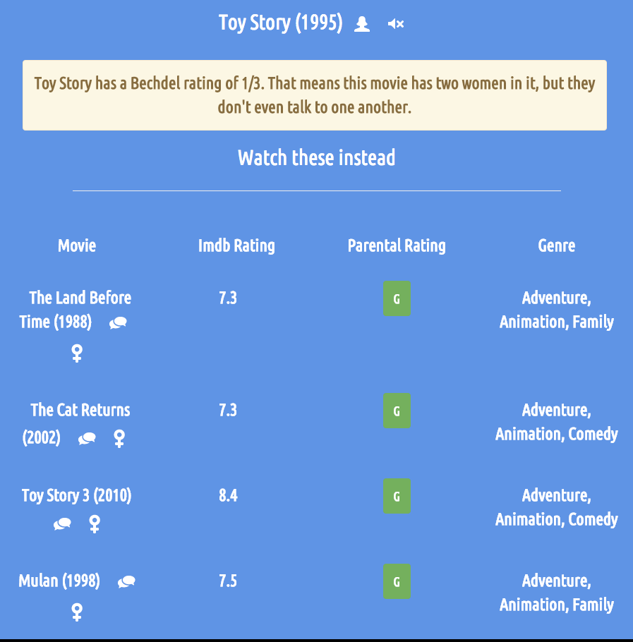
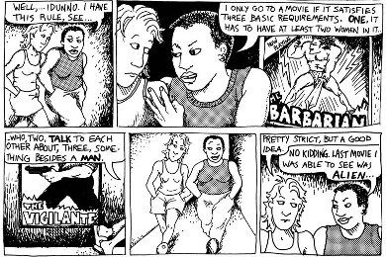

So what's it look like?

Slide 13
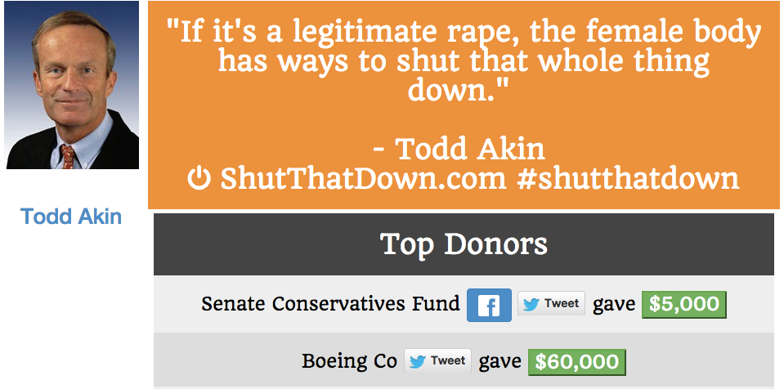
So what's it look like?

Slide 14

sometimes simple is best

Slide 15
The hard part
Finding the right API(s) for your project
Does it exist?
Does it offer what you're looking for in the format you need it?
Ask people
Google it
Read the documentation
Read the terms of service

Slide 16
Terms of service
Rules for how you can use the API
Everyone has their own rules
Some make you sign up for an API key so they can see usage statistics
Some APIs (businesses) are not free
Some are for noncommercial use only
Read it all carefully to make sure you comply!

Slide 17
APIs, the Jargon
JSON: Information returned in a format that has dictionaries, lists, strings, and numbers.
Visualize JSON as a CSV: http://konklone.io/json/
REST: You can create the URL and see the resulting JSON in a web browser.

Slide 18
APIs, the Jargon
Endpoints: A piece of a URL you'll use to form your question to the API.
Some APIs will only have one endpoint; others might have several!
It depends on how many different types of information the API makes available.

Slide 19
A good start
Some APIs from the US Government
http://18f.github.io/API-All-the-X/pages/individual_apis
http://data.gov
Public directory of APIs
http://www.programmableweb.com/apis/directory

Slide 20
start small
http://bechdeltest.com/api/v1/doc
Sample query (copy this in your browser): http://bechdeltest.com/api/v1/getMovieByImdbId?imdbid=0367631
/getMovieByImdbID: the endpoint
imdbid=0367631: the parameter and its value

Slide 21
Exercise
Go to https://github.com/shannonturner/python-lessons/blob/master/playtime/lesson05_firstapi.py
If you finish, let's chat about your long-term goals and project ideas.

Slide 22
Map everything
Go to http://www.ed.gov/news/press-releases/us-department-education-releases-list-higher-education-institutions-open-title-i
and to
https://github.com/shannonturner/education-compliance-reports/blob/master/investigations.json
Also click on 'Raw' to see the JSON

Slide 23
Map everything
That's the same way I made all of the maps here:
https://github.com/shannonturner/survivor-resources
https://github.com/shannonturner/education-compliance-reports

